Slide 1
Sobol’s Total Indices for Accurate and Scalable Feature Exclusion in High-Dimensional Data
Zonghan Zhang, Zhiqian Chen
Computer Science and Engineering
Mississippi State University

Slide 2
Agenda
Motivation and Problem Setup
Sobol vs. Shapley: Methodological Comparison
PID Framework and Theoretical Insights
Empirical Evaluation
Conclusion and Future Work

Slide 3
Motivation
High-dimensional datasets appear everywhere: genomics, healthcare, social networks.
Feature selection is essential for:
Reducing computational cost;
Improving interpretability;
Avoiding overfitting.
However, many attribution methods fail to reflect the true performance loss when removing features.

Slide 4
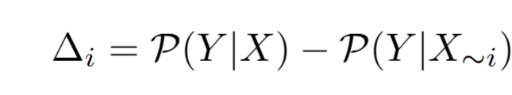
Problem: Performance Loss
Traditional feature selection focuses on identifying a subset maximizing predictive performance.
We instead evaluate:
Core question: Which method best estimates the true performance lost when excluding a feature?

Slide 5
Agenda
Motivation and Problem Setup
Sobol vs. Shapley: Methodological Comparison
PID Framework and Theoretical Insights
Empirical Evaluation
Conclusion and Future Work

Slide 6
Shapley: Strengths & Limitations
Strength:
Game-theoretic fairness; captures interactions in theory; widely used in machine learning (e.g., SHAP)
Limitations:
Allocates interaction effects uniformly
Overestimates redundant features
Underestimates synergistic features
Exponential time complexity
Often misestimates performance loss

Slide 7
Sobol’s Total Indices: Strengths
Advantages:
Variance-based measure
Includes main + all interaction effects
Naturally excludes redundancy
Directly estimates variance lost if the feature is removed
Linear complexity O(n·d)
Fully model-agnostic

Slide 8
Visual Intuition: Sobol vs. Shapley
Sobol directly measures the actual variance lost.
Shapley retains part of interactions that no longer exist.

Slide 9

When Shapley Fails: XOR
$Y=XOR\left(X_{1}, X_{2}\right)$
Removing either feature leads to complete loss
Sobol: $T_{1}=T_{2}=1$
Shapley: $φ_{1}=φ_{2}=0.5$
Shapley undervalues interacting features.

Slide 10

When Shapley Fails: Redundancy
$Y=X_{1}+X_{2}$
$corr\left(X_{1}, X_{2}\right)=1$
Removing either feature leads to zero loss
Sobol: $T_{1}=T_{2}=0$
Shapley: $φ_{1}=φ_{2}=0.5$
Shapley overvalues redundant features.

Slide 11
Agenda
Motivation and Problem Setup
Sobol vs. Shapley: Methodological Comparison
PID Framework and Theoretical Insights
Empirical Evaluation
Conclusion and Future Work

Slide 12
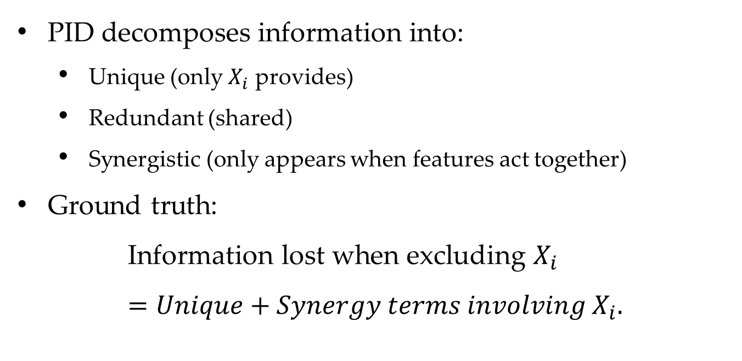
PID Overview
PID decomposes information into:
Unique (only $X_{i}$ provides)
Redundant (shared)
Synergistic (only appears when features act together)
Ground truth:
$$\text{Information} \text{lost} \text{when} \text{excluding} X_{i}=Unique+Synergy terms involving{ X}_{i}.$$

Slide 13
PID Explains the Misalignment
Sobol (right): Captures all interactions and excludes redundancy, correct estimation.
Shapley (left): Splits redundancy and synergy evenly.

Slide 14
Key Theoretical Result
Theorem: Sobol’s indices always align at least as closely with the PID-based ground truth as Shapley values.
Sobol: exact unique + synergy
Shapley: unique + partial synergy + partial redundancy
Takeaway: Sobol provides the right decomposition and the accurate estimation for performance loss.

Slide 15
Agenda
Motivation and Problem Setup
Sobol vs. Shapley: Methodological Comparison
PID Framework and Theoretical Insights
Empirical Evaluation
Conclusion and Future Work

Slide 16
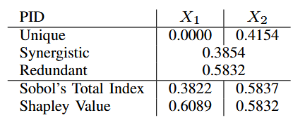
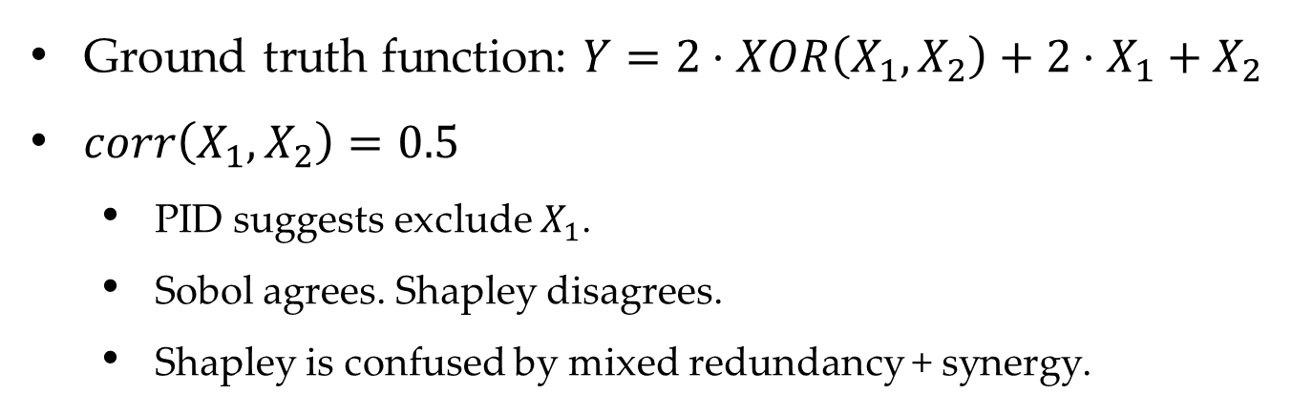
Case Study: Toy Example
Ground truth function: $Y=2⋅XOR\left(X_{1}, X_{2}\right)+2⋅X_{1}+X_{2}$
$corr\left(X_{1}, X_{2}\right)=0.5$
PID suggests exclude $X_{1}$.
Sobol agrees. Shapley disagrees.
Shapley is confused by mixed redundancy + synergy.

Slide 17
Diabetes Dataset (Classification)
Sobol produces a safer exclusion order.

Slide 18
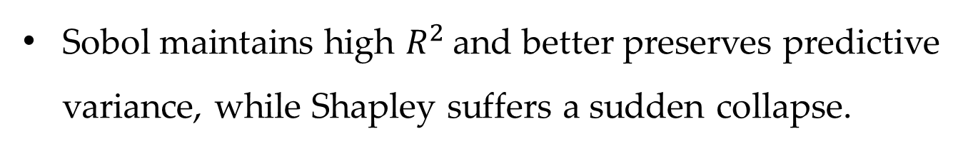
Auto-MPG Dataset (Regression)
Sobol maintains high $R^{2}$ and better preserves predictive variance, while Shapley suffers a sudden collapse.

Slide 19
Runtime Comparison
Sobol’s runtime nearly constant w.r.t feature count.
Shapley exponential growth.
Sobol also scales better with instances.

Slide 20
Agenda
Motivation and Problem Setup
Sobol vs. Shapley: Methodological Comparison
PID Framework and Theoretical Insights
Empirical Evaluation
Conclusion and Future Work

Slide 21
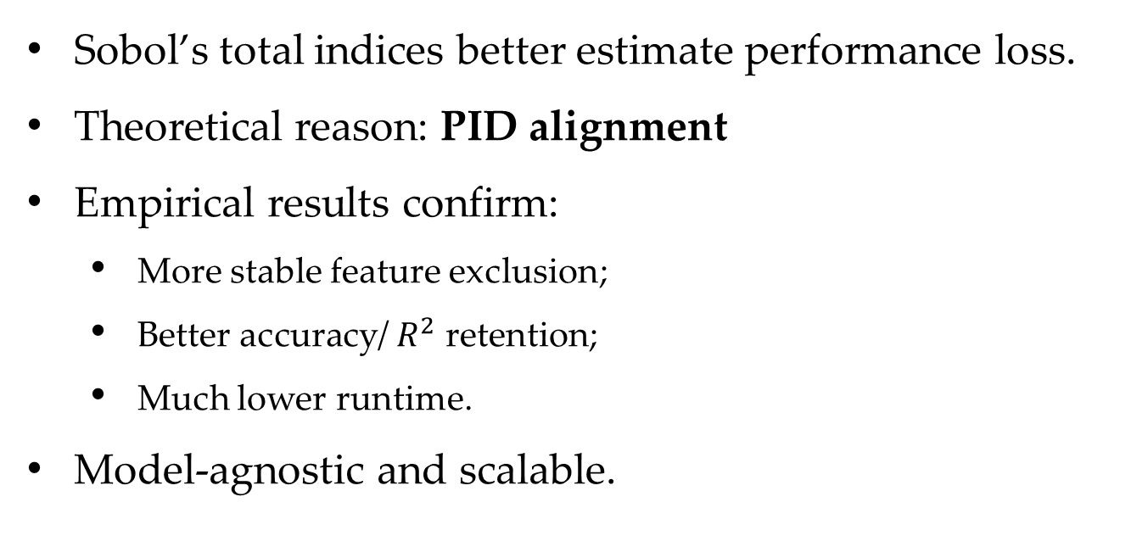
Conclusion
Sobol’s total indices better estimate performance loss.
Theoretical reason: PID alignment
Empirical results confirm:
More stable feature exclusion;
Better accuracy/ $R^{2}$ retention;
Much lower runtime.
Model-agnostic and scalable.

Slide 22
Limitations & Future Work
Limitations:
Large-scale experiments limited due to Shapley computation.
Sobol indices lack interpretability compared with Shapley plots.
Future Work:
Incorporate PID-inspired interactions into new feature selection methods.
Extend to multivariate PID.
Improve interpretability of Sobol indices.

Slide 23


zz239@msstate.edu
Thank you!

